Slide 2
Modular Web Applications with ASP.NET Core
Vignesh Mani

Slide 3
Agenda
Introduction of ASP.NET Core
ASP.NET Core Benefits
ASP.NET Core - Environment Setup
Command-line Interface (CLI)

Slide 4
Command-line Interface (CLI)
ASP.NET Core Version History.
ASP.NET Core Vs ASP.NET
.NET Core Vs .NET Framework.
.NET Standard.

Slide 5
Introduction of ASP.NET Core
Cross-platform framework.
Open-Source framework.
High-performance.
Building modern, Cloud-based.
Windows, macOS, or Linux.
.

Slide 6














Your platform for building anything
DESKTOP
WEB
CLOUD
MOBILE
GAMING
IoT
AI
.NET
Notes:
You can build anything with .NET. We’ve made significant investments in .NET over the years as well as unifying the ecosystem to support building literally anything.

Slide 7
It was initially launched as ASP.NET 5.
It was renamed to ASP.NET Core.
ASP.NET MVC and ASP.NET Web API into a single.
Run on .NET Core and traditional .NET framework
.

Slide 8
.NET Growth Continues
Visual Studio
+1 million new monthly active .NET developers in last year
.NET Core
Over half a million .NET Core 2.0 developers

Slide 9
ASP.NET Core Benefits
Supports Multiple Platforms.
No longer depends on System.Web.dll.
Built-in IoC container for automatic dependency injection
Integration with Modern UI Frameworks

Slide 10
Application can be hosted on multiple platforms.
Open-source and community-focused.
Side-by-Side App Versioning.

Slide 11
ASP. NET Core App
ASP. NET Core App
ASP. NET Core App
ASP. NET Core App
.NET Core
.NET Framework
.NET Core
.NET Core
.NET CORE
.NET CORE 3
Windows
Windows
Linux
Mac
Notes:
ANIMATED SLIDE – shows progression of entire .NET platform into .NET Core specific workloads.
.NET Core is our cross-platform, open source implementation of .NET and is perfectly suited for requirements of cloud-native, cross-platform services. We’ve made significant investments in the core performance as well as the web stack so that you can easily take advantage of cloud patterns and scale.
.NET Core 3 will expand on the supported workloads to include IoT, AI and Windows Desktop.

Slide 12
ASP.NET Core - Environment Setup
.NET Core SDK
Integrated Development Environment (IDE)

Slide 13
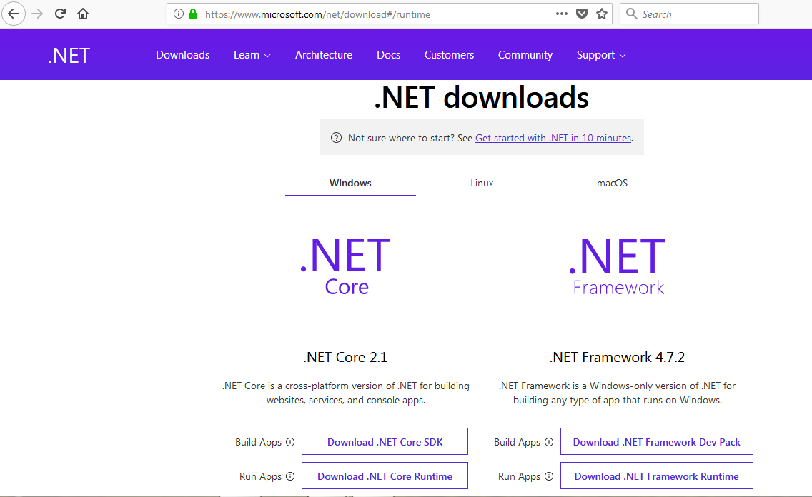
.NET Core SDK - Windows

Slide 14
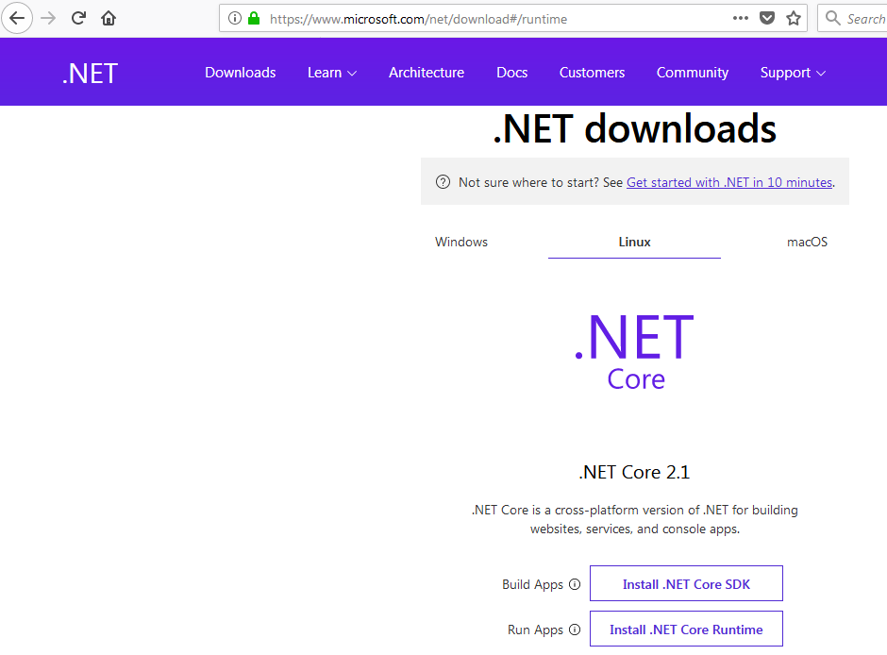
.NET Core SDK - Linux

Slide 15
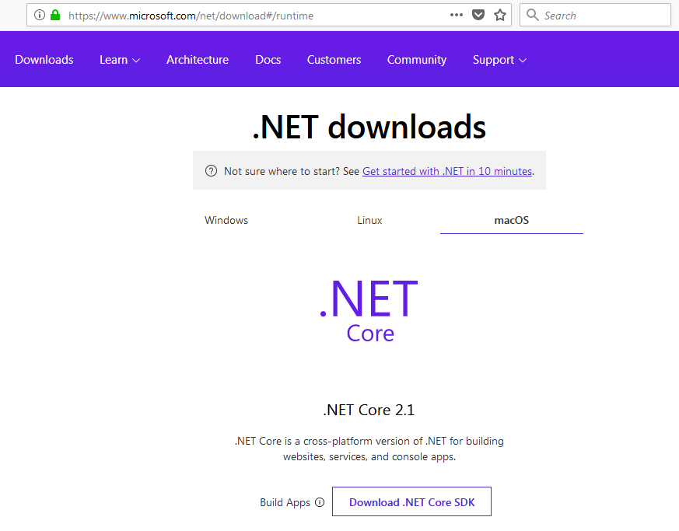
.NET Core SDK - macOS

Slide 16
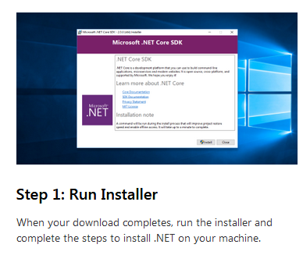

Slide 17
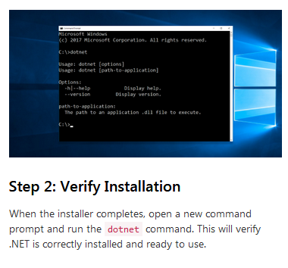

Slide 18
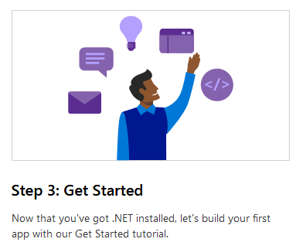

Slide 19
IDE - Visual Studio 2017
Develop, restore, build and run .NET Core application
https://visualstudio.microsoft.com/downloads/

Slide 20
Command-line Interface (CLI)
Create, compile, build, restore and run .NET Core application.
.NET Core SDK installation also installs command-line interface
Can verify it by opening command prompt and type dotnet

Slide 21
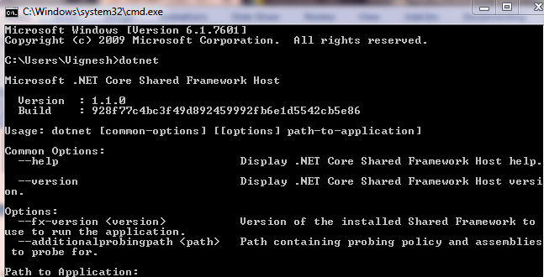

Slide 22
ASP.NET Core Version History
Version Number | Release Date | Development Tool
1.0 | 2016-06-27 | Visual Studio 2015, 2017
1.1 | 2016-11-18 | Visual Studio 2015, 2017
2.0 | 2017-08-14 | Visual Studio 2017
2.1 | 2018-05-30 | Visual Studio 2017
.NET CORE
.NET CORE 3
Notes:
ANIMATED SLIDE – shows progression of entire .NET platform into .NET Core specific workloads.
.NET Core is our cross-platform, open source implementation of .NET and is perfectly suited for requirements of cloud-native, cross-platform services. We’ve made significant investments in the core performance as well as the web stack so that you can easily take advantage of cloud patterns and scale.
.NET Core 3 will expand on the supported workloads to include IoT, AI and Windows Desktop.

Slide 23
ASP.NET Core Vs ASP.NET
ASP.NET Core | ASP.NET
Build for Windows, macOS, or Linux | Build for Windows
Razor Pages is the recommended approach to create a Web UI as of ASP.NET Core. | Use Web Forms, SignalR, MVC, Web API, WebHooks, or Web Pages
Multiple versions per machine | One version per machine
Develop with Visual Studio, Visual Studio for Mac, or Visual Studio Code using C# or F# | Develop with Visual Studio using C#, VB, or F#
Higher performance than ASP.NET | Good performance
Choose .NET Framework or .NET Core runtime | Use .NET Framework runtime
.NET CORE
.NET CORE 3
Notes:
ANIMATED SLIDE – shows progression of entire .NET platform into .NET Core specific workloads.
.NET Core is our cross-platform, open source implementation of .NET and is perfectly suited for requirements of cloud-native, cross-platform services. We’ve made significant investments in the core performance as well as the web stack so that you can easily take advantage of cloud patterns and scale.
.NET Core 3 will expand on the supported workloads to include IoT, AI and Windows Desktop.

Slide 24
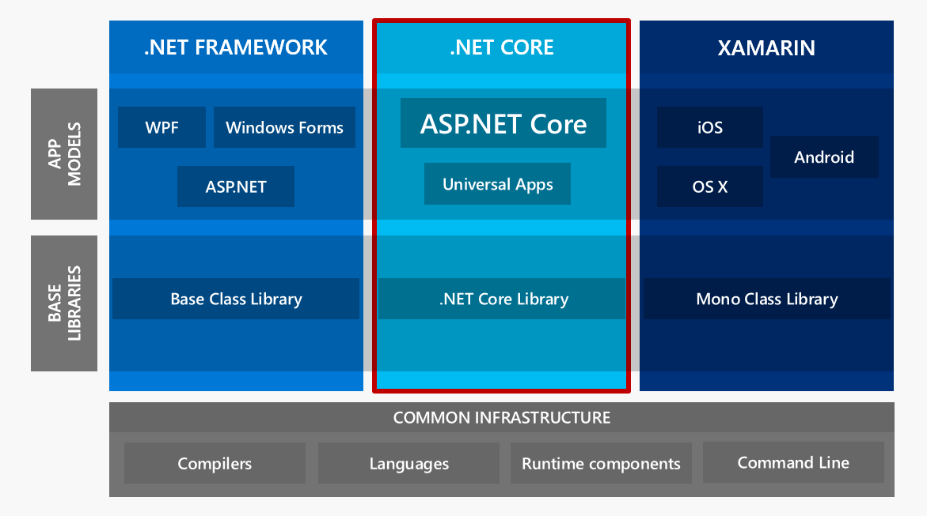
.NET CORE
.NET CORE 3
Notes:
ANIMATED SLIDE – shows progression of entire .NET platform into .NET Core specific workloads.
.NET Core is our cross-platform, open source implementation of .NET and is perfectly suited for requirements of cloud-native, cross-platform services. We’ve made significant investments in the core performance as well as the web stack so that you can easily take advantage of cloud patterns and scale.
.NET Core 3 will expand on the supported workloads to include IoT, AI and Windows Desktop.

Slide 25
.NET Standard
Shared API also called .NET Standard.
Formal specification of .NET APIs.
It is available on all .NET implementations.
Defines uniform set of BCL APIs for all .NET implementations to implement, independent of workload.

Slide 26
Enables developers to produce portable libraries that are usable across .NET implementations, using this same set of APIs.

Slide 27
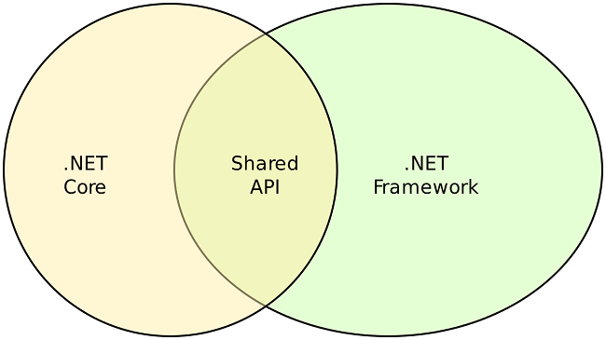
.NET CORE
.NET CORE 3
Notes:
ANIMATED SLIDE – shows progression of entire .NET platform into .NET Core specific workloads.
.NET Core is our cross-platform, open source implementation of .NET and is perfectly suited for requirements of cloud-native, cross-platform services. We’ve made significant investments in the core performance as well as the web stack so that you can easily take advantage of cloud patterns and scale.
.NET Core 3 will expand on the supported workloads to include IoT, AI and Windows Desktop.

Slide 28
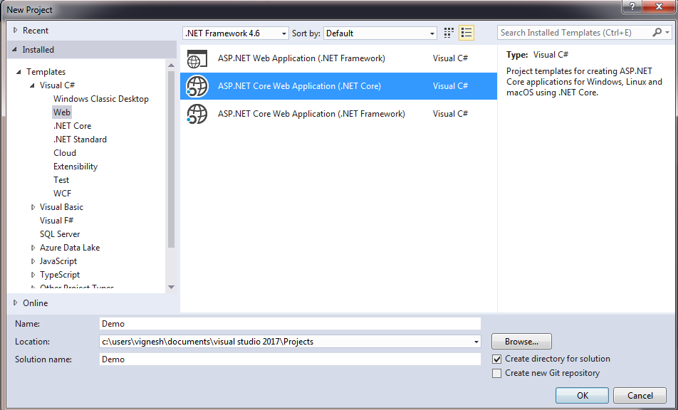
Step 1

Slide 29
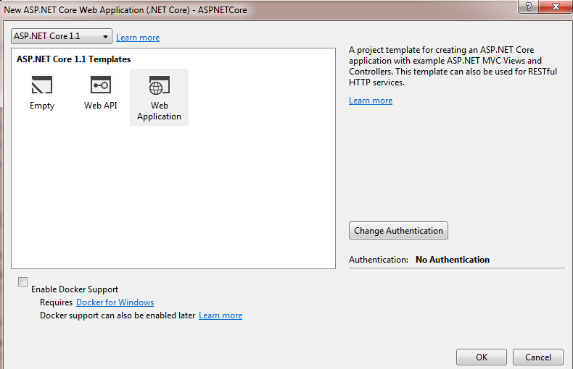
Step 2

Slide 30
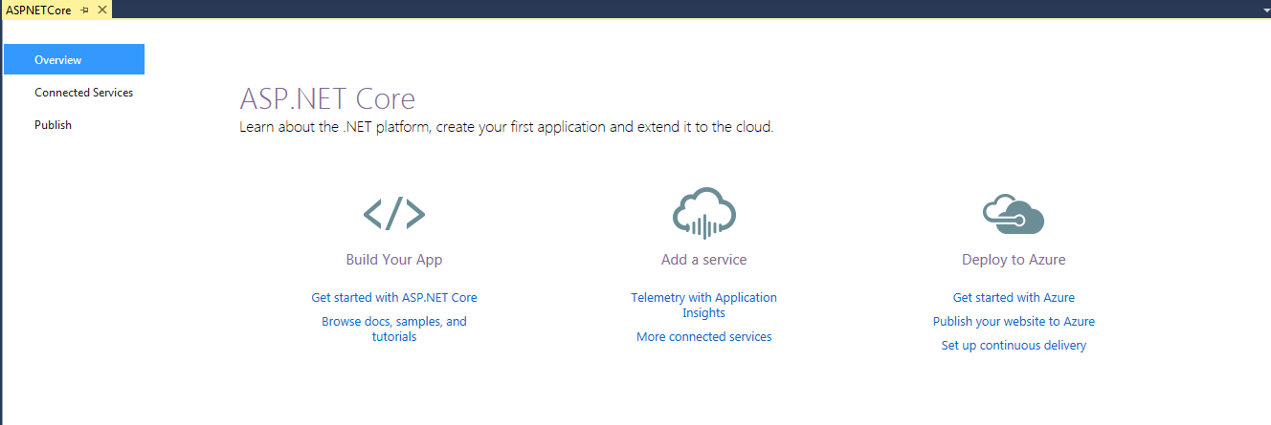
Step 3

Slide 31
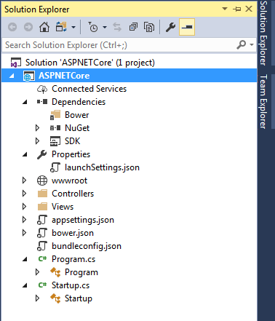
Step 4

Slide 32
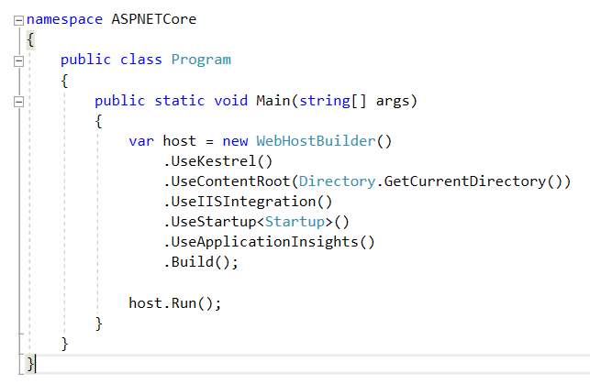

Slide 33
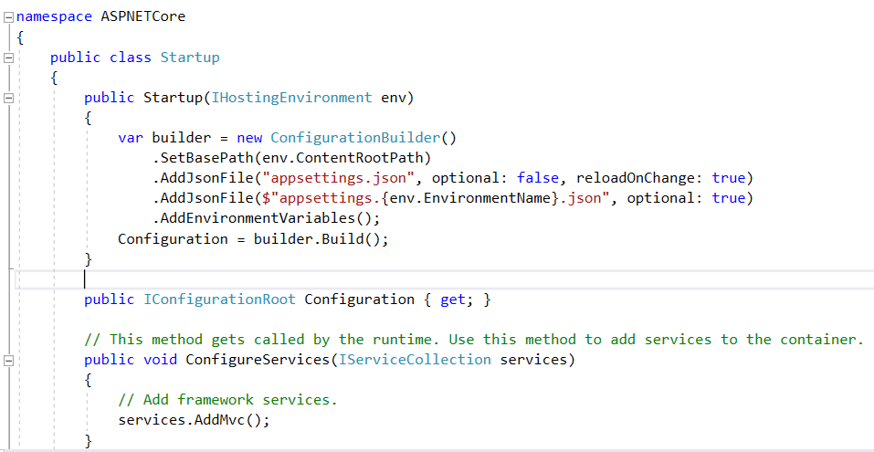

Slide 34
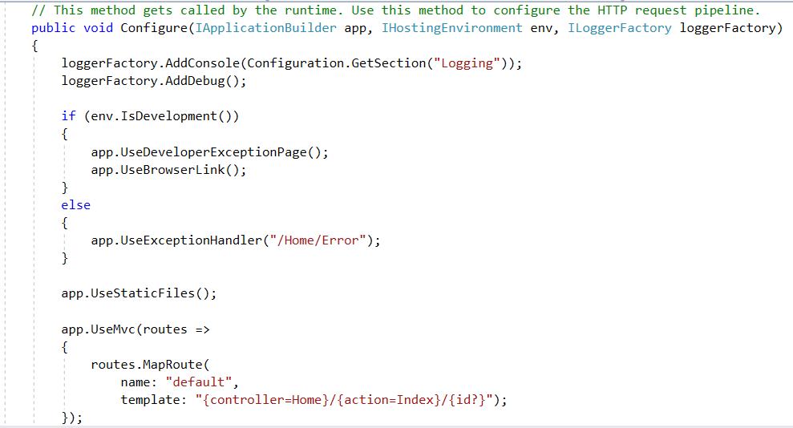

Slide 35
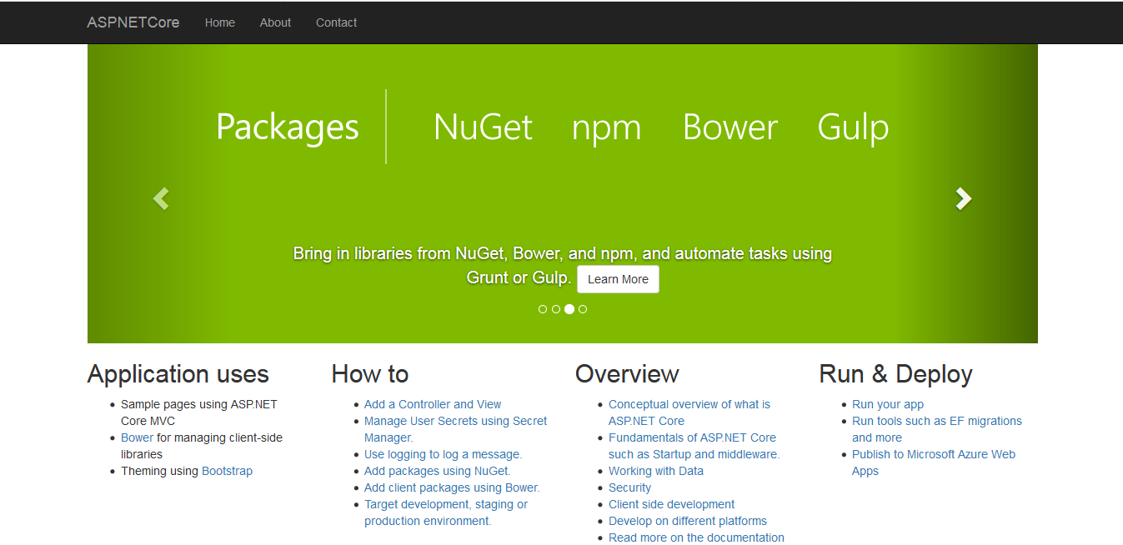

Slide 36
.NET Core 2.1 Major Features
.NET Core
Lazy Loading
Value conversions
Query types
Data seeding
ASP.NET Core
Global Tools
Span<T>
Sockets
HttpClient Performance
Windows Compatibility Pack
EF Core
HTTPS
Razor UI as a library
HttpClientFactory
ASP.NET Core SignalR

Slide 37
.NET Core 2.2 Major Features
.NET Core
Cosmos DB provider
Spatial extensions for SQL Server and SQLite providers
Reverse engineering of database views
Collections of owned entities
Query tagging
ASP.NET Core
Multi-tier JIT compilation
SQL Connection token auth
EF Core
Template updates: Bootstrap 4, Angular 6
Web API improvements, including API security
HTTP/2
IIS in-process hosting
Health checks
Endpoint routing
SignalR Java client

Slide 38
.NET Core 2.2 Themes
Improved Web API Development
Microservices and Azure
Continued Performance Improvements

Slide 39



Contact
+91 9788004734
mcavickymas@gmail.com
@mcavickymas

Slide 40
Thank You

